Slide 1
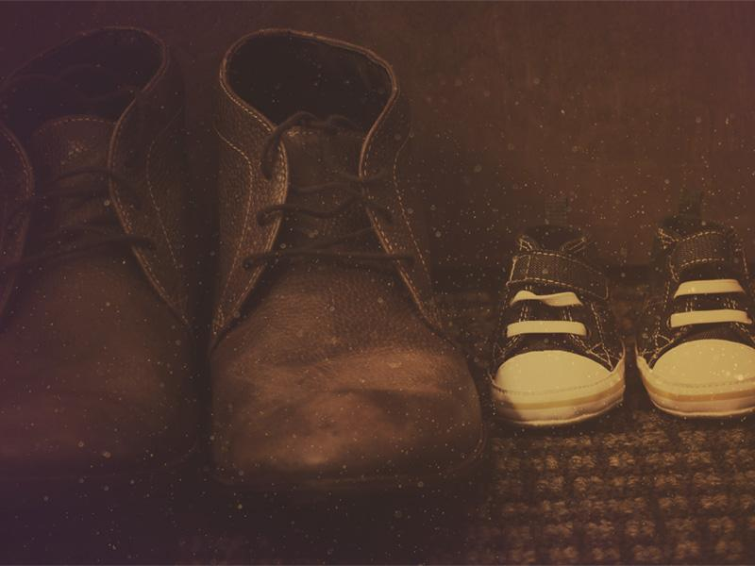
ELA 9 5/30 “In Their Shoes” activity
Please take out a blank sheet of paper and a pen or a pencil.

Slide 2
Understanding the Perspectives of others— a major theme in Mockingbird
“As Atticus had once advised me to do, I tried to climb into Jem’s skin and walk around in it…”
“Atticus was right. One time he said you never really know a man until you stand in his shoes and walk around in them.”

Slide 3
Project Goals
Understand what shapes the lives and perspective of the people around you.
Interview a classmate and present what makes him/her distinct.
Create a visual representation of what makes another classmate unique by combining both art and language.

Slide 4
Top 3 Lists
What are three of your passions in life?
People who have influenced you?
Favorite movies or TV shows
Places
What are three of your pet peeves?
Colors, shapes, or patterns.
What are three words others would use to describe you?
If you could change three things in the world, what would they be?

Slide 5
Today’s goals
10 minutes to prepare for interview
20 minutes to interview each other (make sure you write down good quotes!)
5-10 minutes to draw each other’s shoes
Tomorrow: finishing your shoe & paragraph (prepare well today! Bring markers, colored pencils if desired tomorrow)

Slide 6
Sample Interview Questions (with follow-up)
1. What kind of shoes were you wearing when we made the poster?
2. What influenced you to wear them?
3. What are some of your passions in life?
_____________ sounds interesting. How did you get into that? What’s your favorite parts about it?
4. If you could change something in the world…?

Slide 7
Interview Project-interview the person sitting next to you going clockwise
Interview a classmate so you can present what makes him/her “distinct”—and more than meets the eye.
Step 1: Create around 6-7 interview questions. Some may be about the Top Three Lists.
Step 2: Interview & make sure to ask follow-up questions.
Remember to record at least two quotes!

Slide 8
draw your partner’s shoe. You will draw simultaneously!
Somewhere on or near the shoe:
Write the person’s name.
Fill the shoe with images, patterns, colors, etc. that represent them. Share your Top 3 Lists to get ideas.

Slide 9
Write at least a ½ page on your classmate. You must incorporate at least two quotes from your interview
You will have to introduce your partner by reading what you wrote.

Slide 10
Grade Categories
Poster: Showing attention to detail when drawing the show and adding required artistic and linguistic elements.
Writing: Clarity and originality of description and personal anecdotes
Presenting to your group.

Slide 11
APEL 5/28: Literature Circles
Please sit with your literature circle group. You should get out a copy of your book, as well as a piece of paper for discussion notes.

Slide 12
Discussion Questions
Summarize the important events from today’s reading.
What questions do you have about what you read today?
What was the most interesting thing you read today?
Which character you identify with and why?
Are there are any characters that seem suspicious? Why?
What do you predict will happen next?

